Slide 1

Exploratory Data Analysis
G2M insight for Cab Investment firm
11/10/2021

Slide 2

Agenda
Executive Summary
Problem Statement
Approach
EDA
EDA Summary
Recommendations

Slide 3
Executive Summary
XYZ is a private firm in US. Due to remarkable growth in the Cab Industry in last few years and multiple key players in the market, it is planning for an investment in Cab industry and as per their Go-to-Market(G2M) strategy they want to understand the market before taking final decision.
Objective : Provide insights to help XYZ’s Executive team in identifying the right company for making investment.
The analysis has been divided into four parts:
Data Exploration
Finding the number of rides for each cab Company
Finding the most used Cab company by customers
Finding the most profitable Cab company
Conclusion about which company to invest in

Slide 4
Data Exploration
4 datasets were merged in order to fully explore the data and extract useful insights.
Total of 11 Features were critical to reach meaningful insights.
Timeframe of the data: 2016-01-31 to 2018-12-31
Total data points : 355,032
Assumptions:
Outliers are present in the date of travel feature as there were dates outside the specified date interval.
Profit of rides is calculated by getting the difference between
Price Charged and Cost of Trip features.

Slide 5
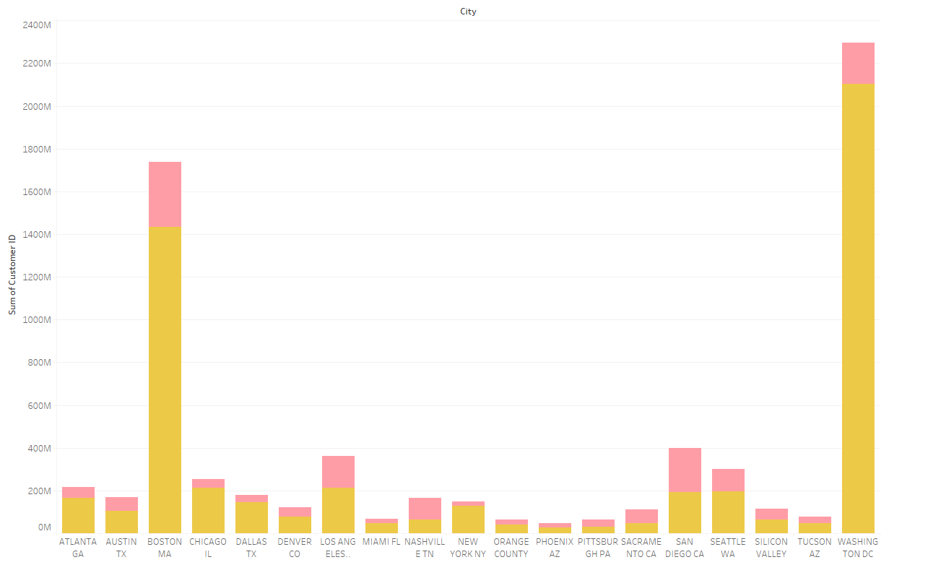
As shown, the number of customers for the yellow company in each city is higher.
EDA

Slide 6
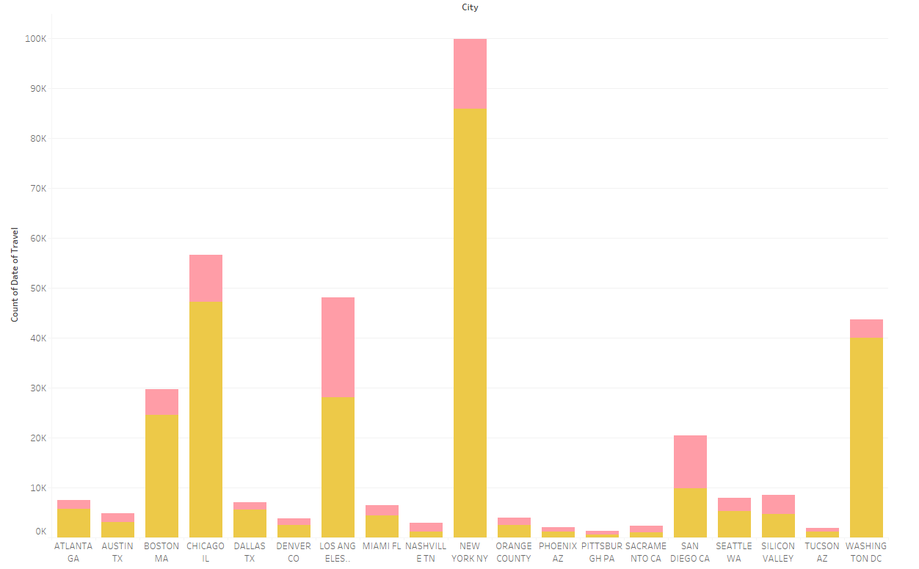
As shown, the number of trips for the yellow company in each city is higher.
EDA

Slide 7
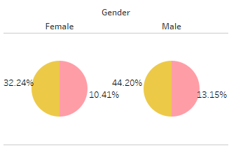
As shown, the percentage of female and male customers are higher for the yellow company .
EDA

Slide 8
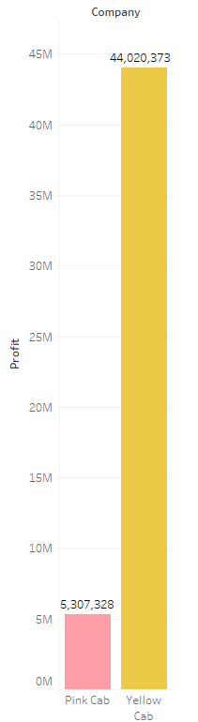
As shown, the profit for the yellow company is much higher compared to pink company.
EDA

Slide 9
EDA Summary and Recommendations
Based on the previous slides we can summarize our data exploratory insights as the following:
1- The number of users to the Yellow company is much higher.
2- The popularity of the Yellow company is broader.
3- When comparing genders, Yellow company excels in both gender type.
4- The profit for the Yellow company exceeds the profit of the Pink company.
And finally, we can say that the best company to invest in is the Yellow company.

Slide 10
Thank You

